Slide 1



Resume and Cover Letter Tips
Your Best Starts Now

Slide 2

Agenda
Each year at RBC, we hire approximately
Cover Letter Overview and Quick Tips
Resume Writing Overview and Quick Tips
Resume Do’s and Don’ts
How to Showcase Your RBC Work Term
Job Search Tips
Sample Resumes

Slide 3


Cover Letter Overview
Your Best Starts Now

Slide 4


What is a Cover Letter?
A resume gives a concise snapshot of your experience for specific positions whereas a cover letter allows
you to share more details about your background to a specific employer’s company.
Cover letters should include the following sections:
Organize your cover letter:
Writing the letter:
Format the Heading Write the Body Conclude with “Yours Sincerely,” or “Regards” and leave space for your signature Proofread.

Slide 5

Cover Letter Quick Tips
Keep the cover letter to one page
Your tone should be upbeat, professional and informative.
Don’t use meaningless or wordy expressions.
Your cover letter should compliment, not duplicate your resume.
Your cover letter is often the first contact with an employer. Make sure it creates a good impression.
Take the time to target your cover letter to the job you are applying for. Be sure to tailor your letter for each position/company.
Before you send your cover letter out, proofread, edit, and revise it.

Slide 6

Resume Writing Overview

Slide 7
Resume Quick Tips
We Suggest the Following Resume order:
Personal Information
Highlights of Qualifications
Formal Education
Work Experience
Volunteer/Extracurricular Experience
Awards/Achievements

Slide 8




Resume Do’s
State results of contributions in each bullet point
Reverse chronological order and dates of participation/hire (month/year)
Proofread and spell check (or ask someone else to!)
Include skills listed in the job description 2+ times in the body of the resume
Include links to LinkedIn and other personal websites i.e. personal portfolio

Slide 9


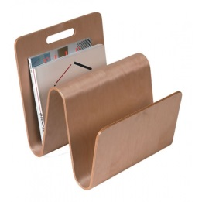
Resume Don’ts
Address your cover letter and resume to another company i.e. TD Bank
Apply with the same resume to different jobs (make sure to tailor your resume to each job you apply to
Leave out details on responsibilities and accomplishments for work experience, extracurricular and volunteer activities

Slide 10

Bonus Tips!
Only use Objective Statement if it is specific and adds value to your resume
Add any personal projects
Leave References off your resume for additional space
Keep consistent formatting throughout the entire resume
No pictures of yourself!

Slide 11

Job Search Tips

Slide 12
How to Showcase your RBC Work Term
Clearly outline company name, job title and work term dates (also include job type so it is clear this was a co-op role i.e. “Project Control Officer Co-op Student”)
List 5-6 bullets which detail your core job duties, projects you were involved in/managed and actionable results/outcomes. Highlight the impact you made in the role.
Ensure to include any over-and-above work you completed as well as any volunteer work you were part of, events you attended i.e. Hackathons
Ensure to include any new skills (technical or soft) you gained in your Skills Summary section

Slide 13
Interested in RBC Student or New Grad Roles?
Talk to your Manager – express your interest in returning!
Contact Campus Recruitment
Network, network, network!
Apply Online – Careers Page and Talent Link

Slide 14
Sample Resumes
Your Best Starts Now

Slide 15
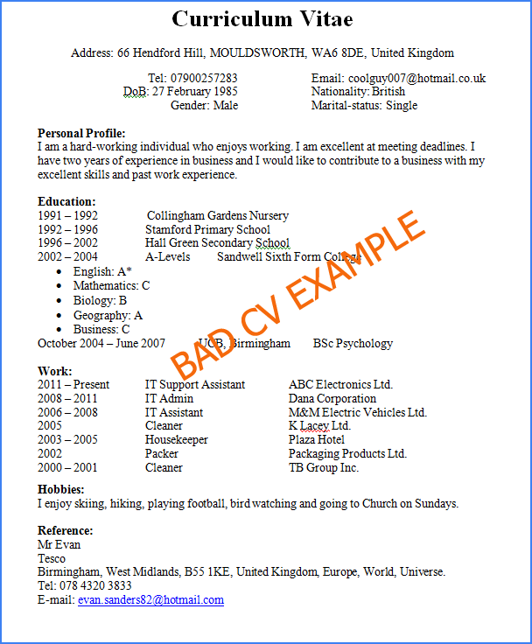
llllllllllllllllllllllllllllllllllllllllllllllllllllllllllllllllllllllllllllllllllllllllllll
IMAGE HERE

Slide 16
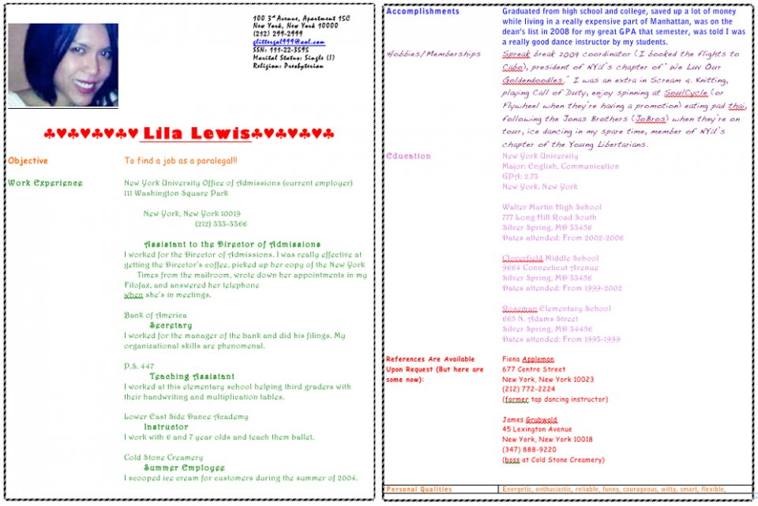
Each year at RBC, we hire approximately
IMAGE HERE

Slide 17
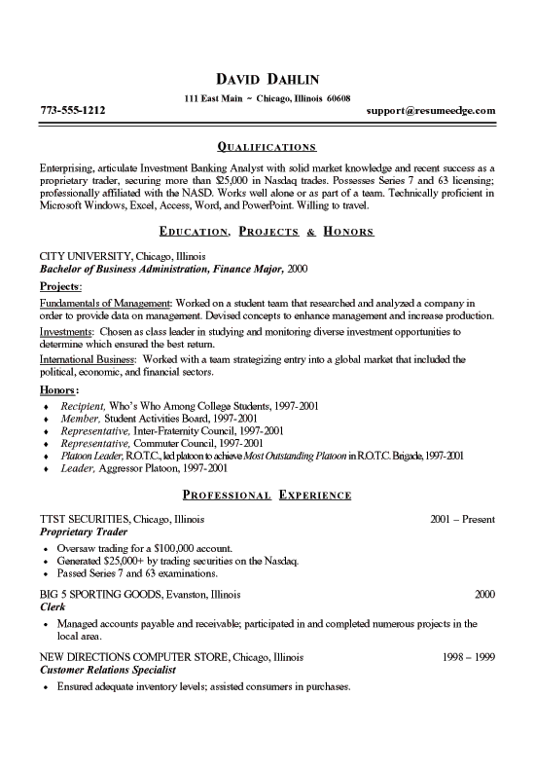

Each year at RBC, we hire approximately
IMAGE HERE

Slide 18
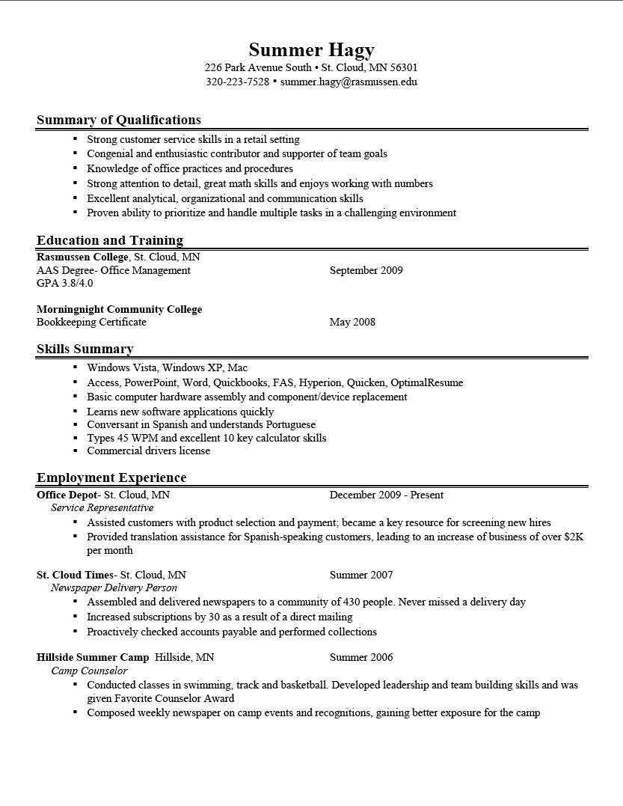
Each year at RBC, we hire approximately
IMAGE HERE

Slide 19
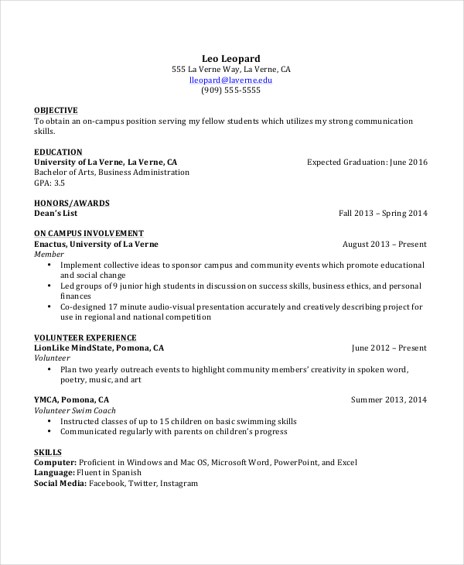
Each year at RBC, we hire approximately
IMAGE HERE

Slide 20
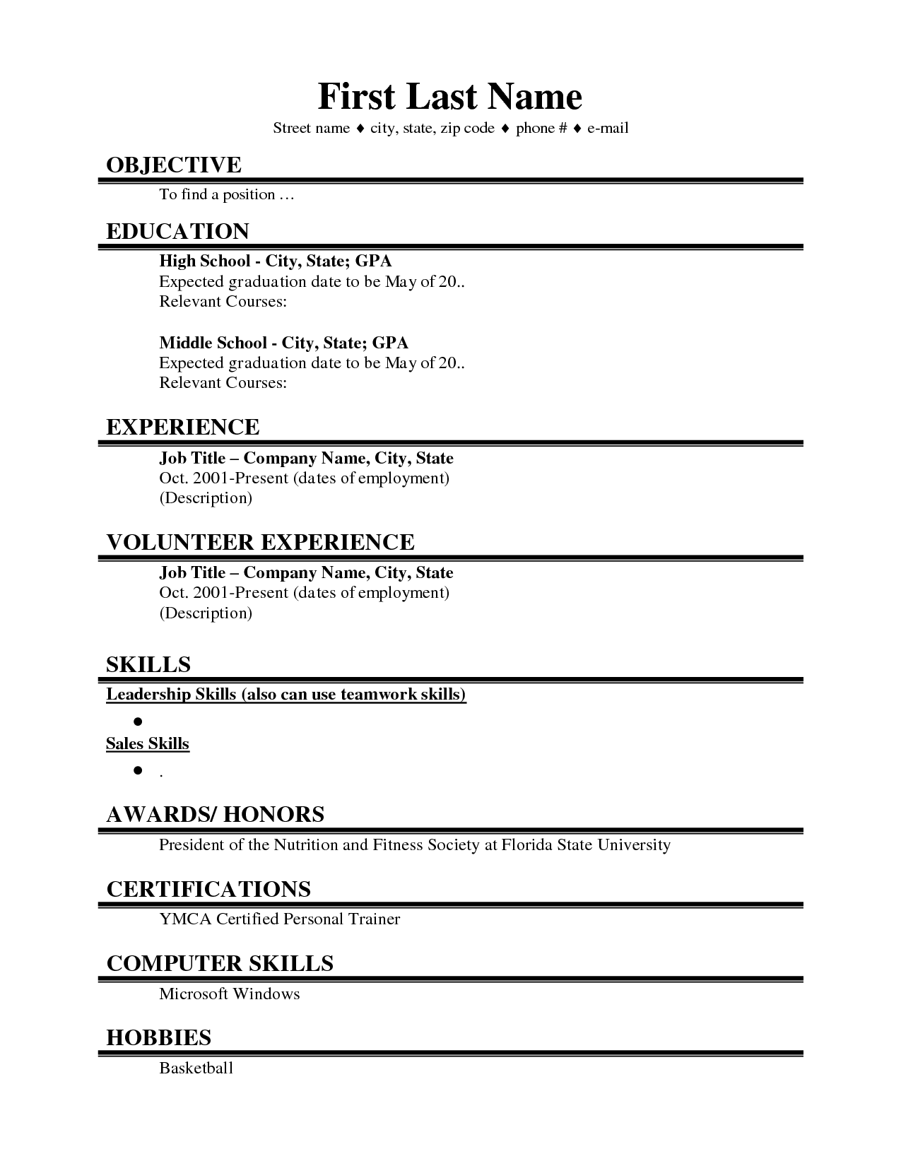
Each year at RBC, we hire approximately
Resume Template
IMAGE HERE

